Slide 1
Today: An Experiment
3 people have mentioned to me that they really miss the handwriting from Manuel’s lectures.
But at least one person was quite perplexed to hear I would abandon the clarity of slides.
Today I’ll do an experiment where I’ll handwrite on my slides. Let me know what you think at the end!

Slide 2
Continuous Probability Distributions
Continuous Probability Distributions
The Exponential Distribution
Expectation and Variance
Joint Distributions and Independence
Summary and Reflections
Lecture 23, CS70 Fall 2025

Slide 3

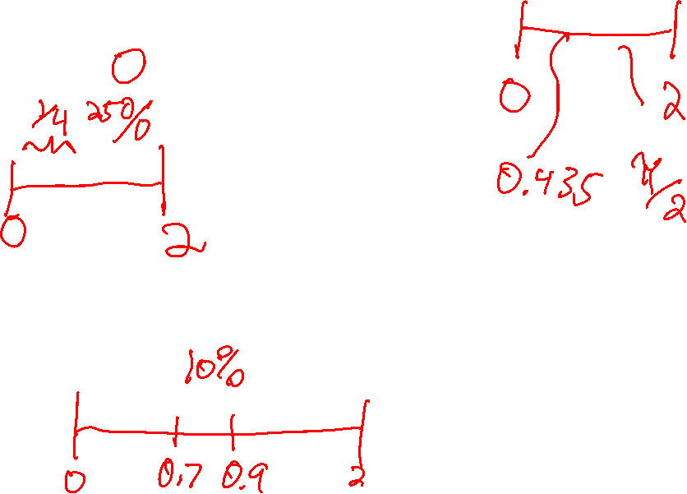
Framing: A Random Variable with Range [0, 2]
Imagine that we choose a real number $X$, uniformly at random from $[0, 2]$
What is the probability that $X = 0.3$?
What is $P\left(X≤1/2\right)$?
What is $P\left(X∈\left[0.7, 0.9\right]\right)$?

Slide 4
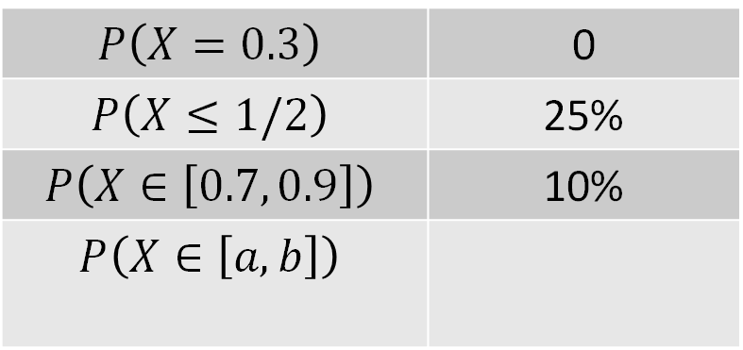

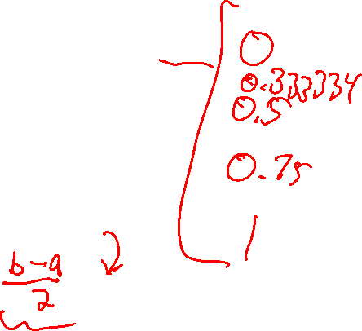
Framing: A Random Variable with Range [0, 2]
Imagine that we choose a real number $X$, uniformly at random from $[0, 2]$
What is $P\left(X∈\left[a, b\right]\right)$?
Following the pattern from $P\left(X∈\left[0.7, 0.9\right]\right)$, we can fill in the table below:
$$P\left(X=0.3\right)$$ | 0
$$P\left(X≤1/2\right)$$ | 25%
$$P\left(X∈\left[0.7, 0.9\right]\right)$$ | 10%
$$P\left(X∈\left[a, b\right]\right)$$

Slide 5
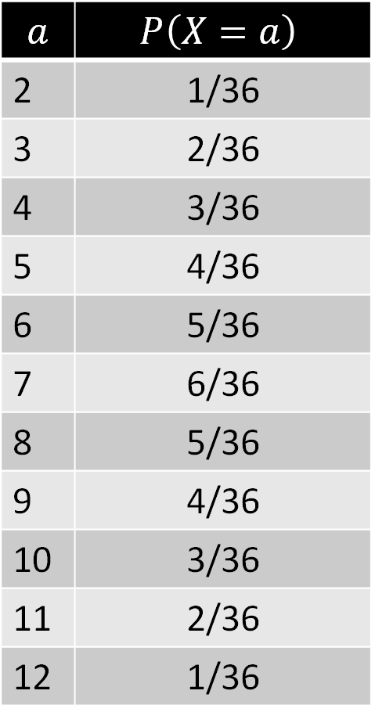
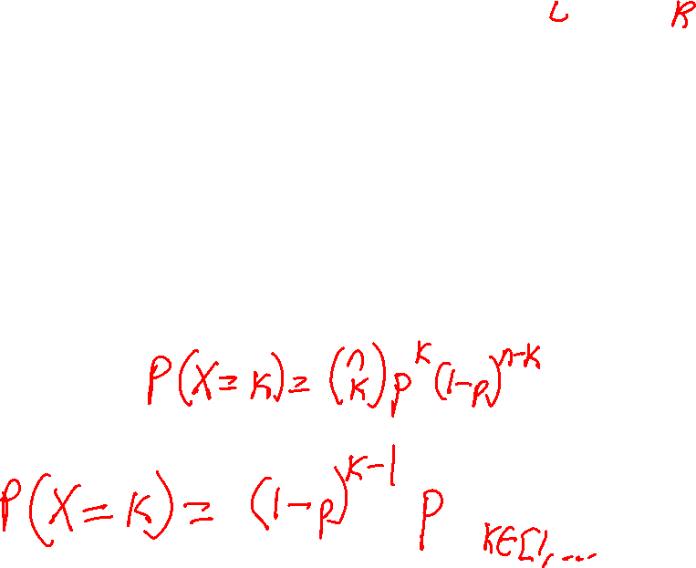
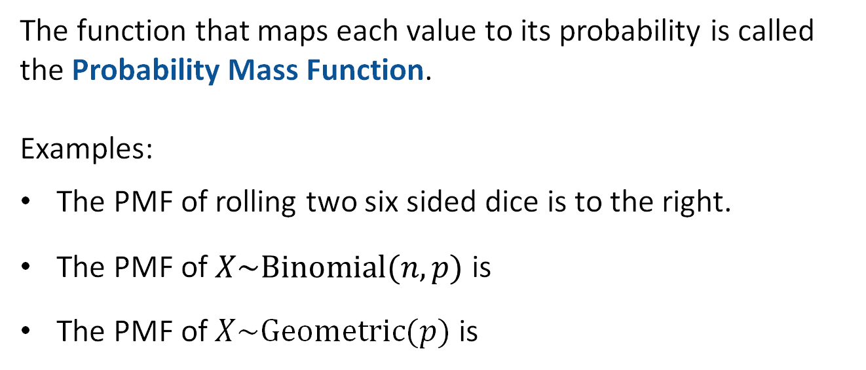
Review: Distributions of Discrete Random Variables
For a discrete random variable, we have the notion of the distribution of a random variable.
Enumeration of every value and its probability.
$$a$$ | $$P\left(X=a\right)$$
2 | 1/36
3 | 2/36
4 | 3/36
5 | 4/36
6 | 5/36
7 | 6/36
8 | 5/36
9 | 4/36
10 | 3/36
11 | 2/36
12 | 1/36
The function that maps each value to its probability is called the Probability Mass Function.
Examples:
The PMF of rolling two six sided dice is to the right.
The PMF of $X\sim Binomial(n, p)$ is $\left({n \atop i}\right)p^{i}{\left(1−p\right)}^{n−i}$
The PMF of $X\sim Geometric(p)$ is ${\left(1−p\right)}^{i−1}p$
PMF is just a new term for something we’ve seen before.

Slide 6

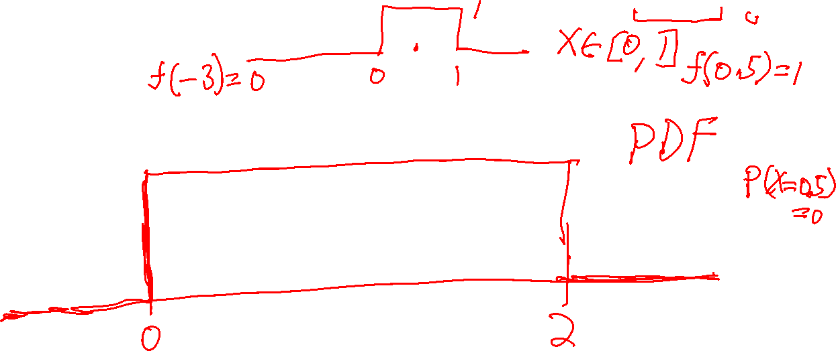
Framing: A Random Variable with Range [0, 2]
Imagine that we choose a real number $X$, uniformly at random from $[0, 2]$
For this random variable, the probability mass function is not useful. $P\left(X=0.3\right)=0$, for all $x∈\left[0, 2\right]$.
There is, however, a useful analogue called the “probability density function”, that looks like this:

Slide 7
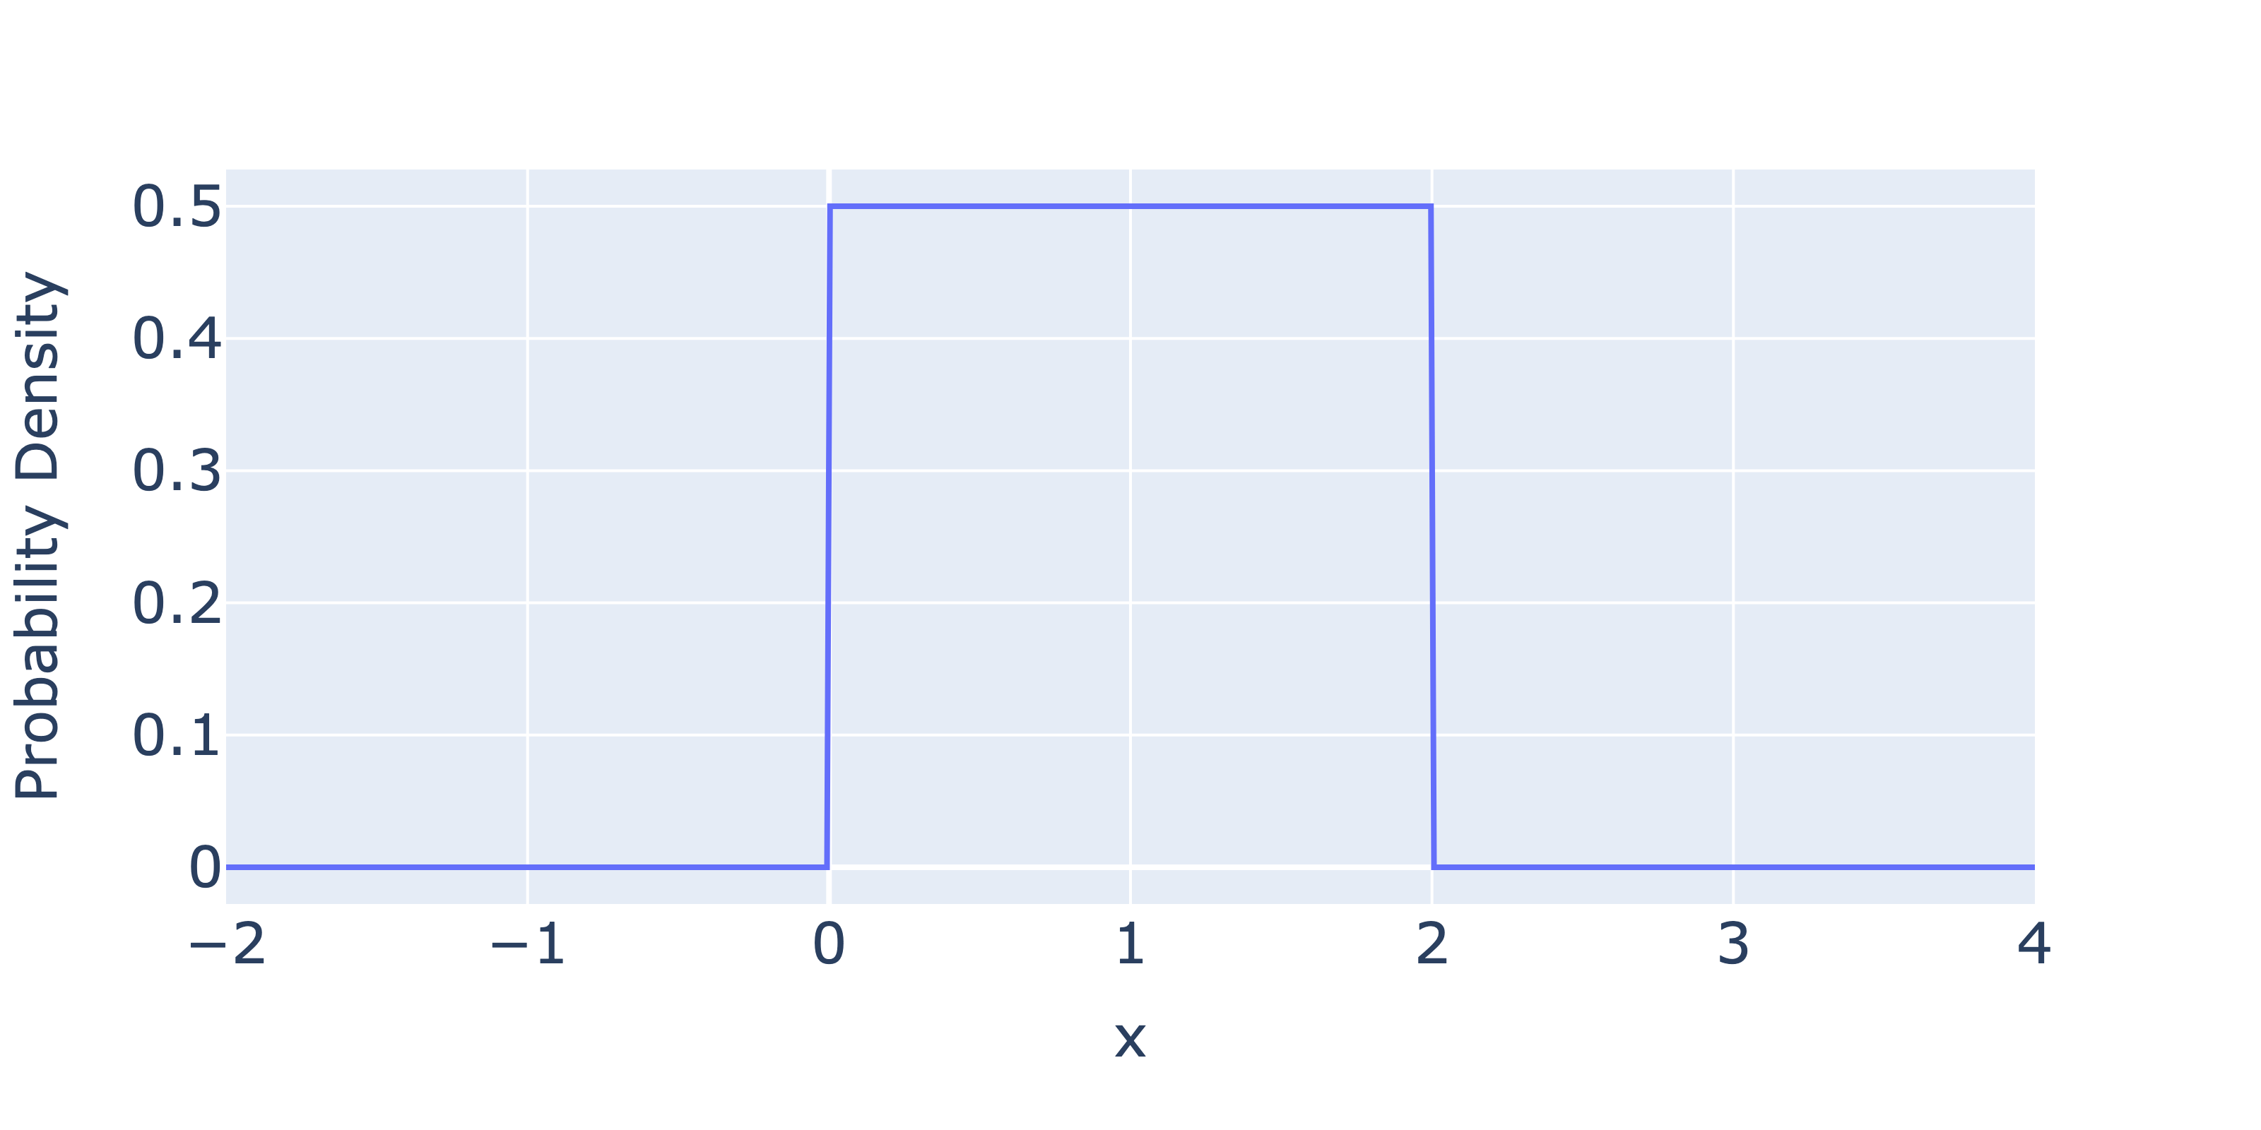

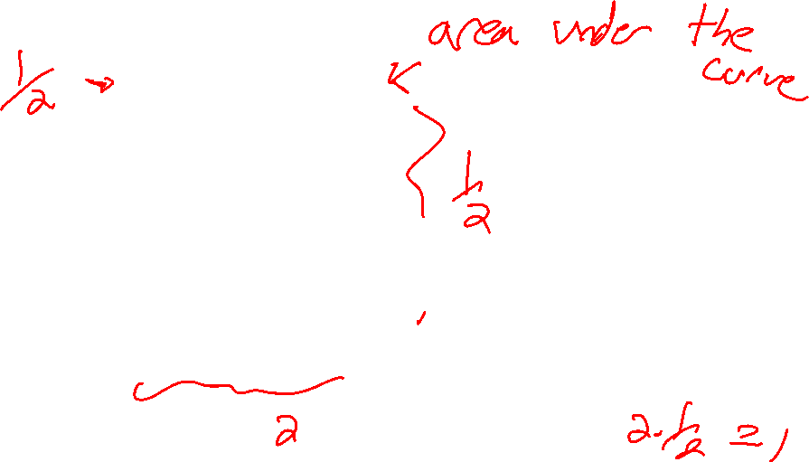
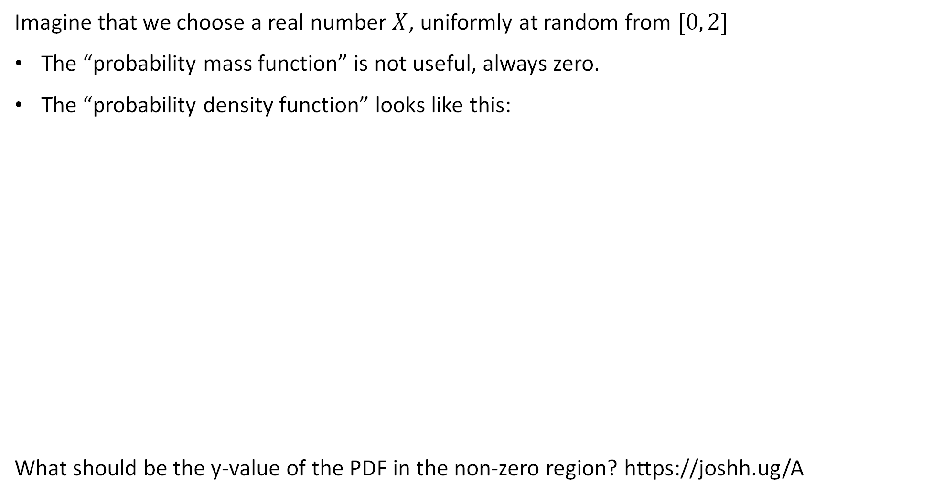
Framing: A Random Variable with Range [0, 2]
Imagine that we choose a real number $X$, uniformly at random from $[0, 2]$
The “probability mass function” is not useful, always zero.
The “probability density function” looks like this:
What should be the y-value of the PDF in the non-zero region? https://joshh.ug/A

Slide 8
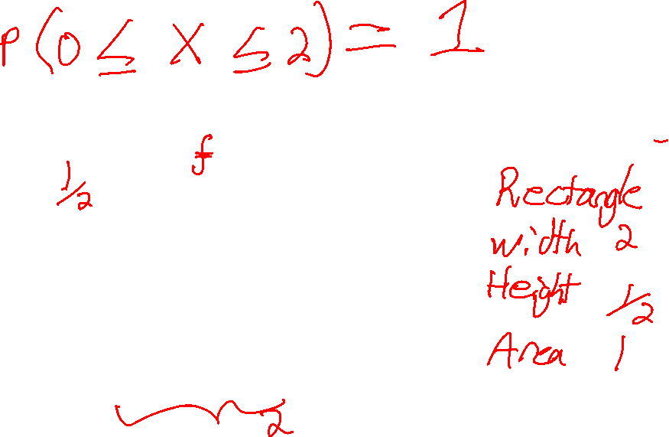
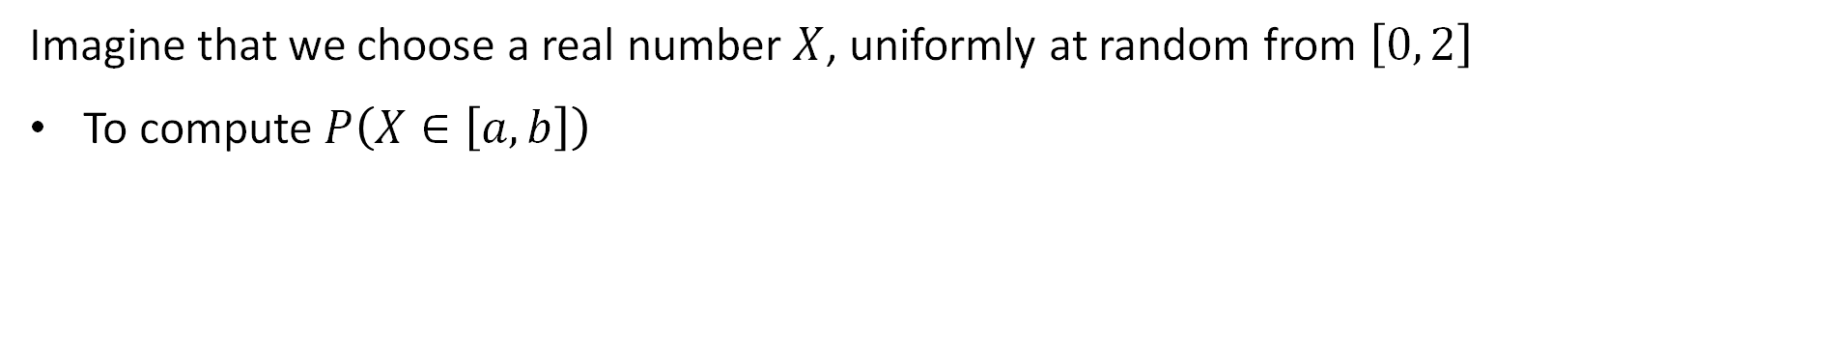
Framing: A Random Variable with Range [0, 2]
Imagine that we choose a real number $X$, uniformly at random from $\left[0, 2\right]$
To compute $P\left(X∈\left[a, b\right]\right)$

Slide 9

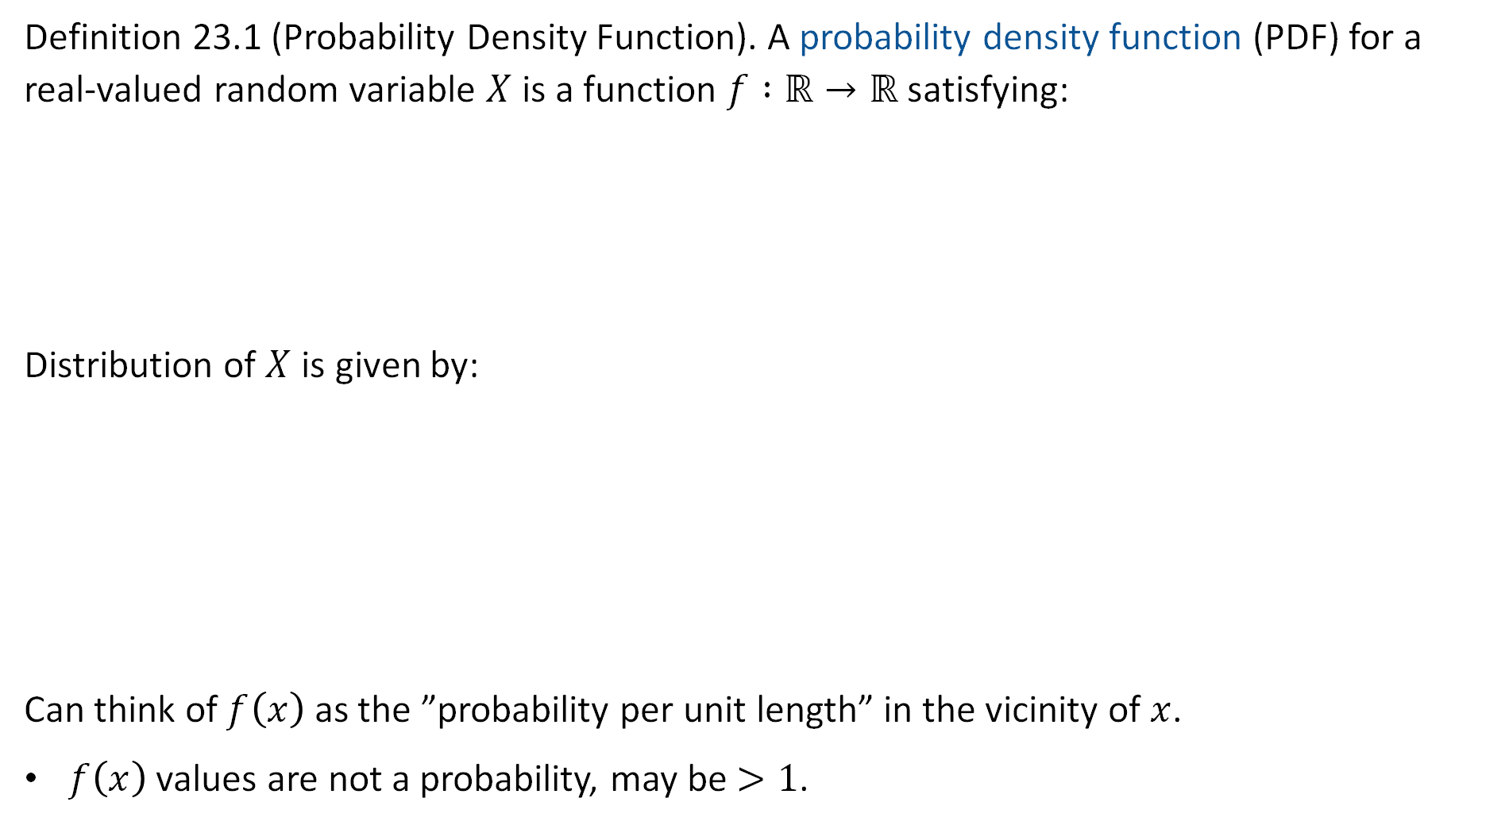
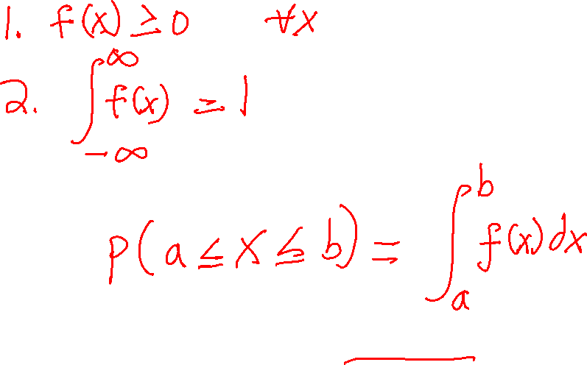
Probability Density Function (as described in the notes)
Definition 23.1 (Probability Density Function). A probability density function (PDF) for a real-valued random variable $X$ is a function $f :ℝ→ℝ$ satisfying:
Distribution of $X$ is given by:
Can think of $f\left(x\right)$ as the ”probability per unit length” in the vicinity of $x$.
$f\left(x\right)$ values are not a probability, may be $>1$.
PDF is usually lowercase $f$

Slide 10

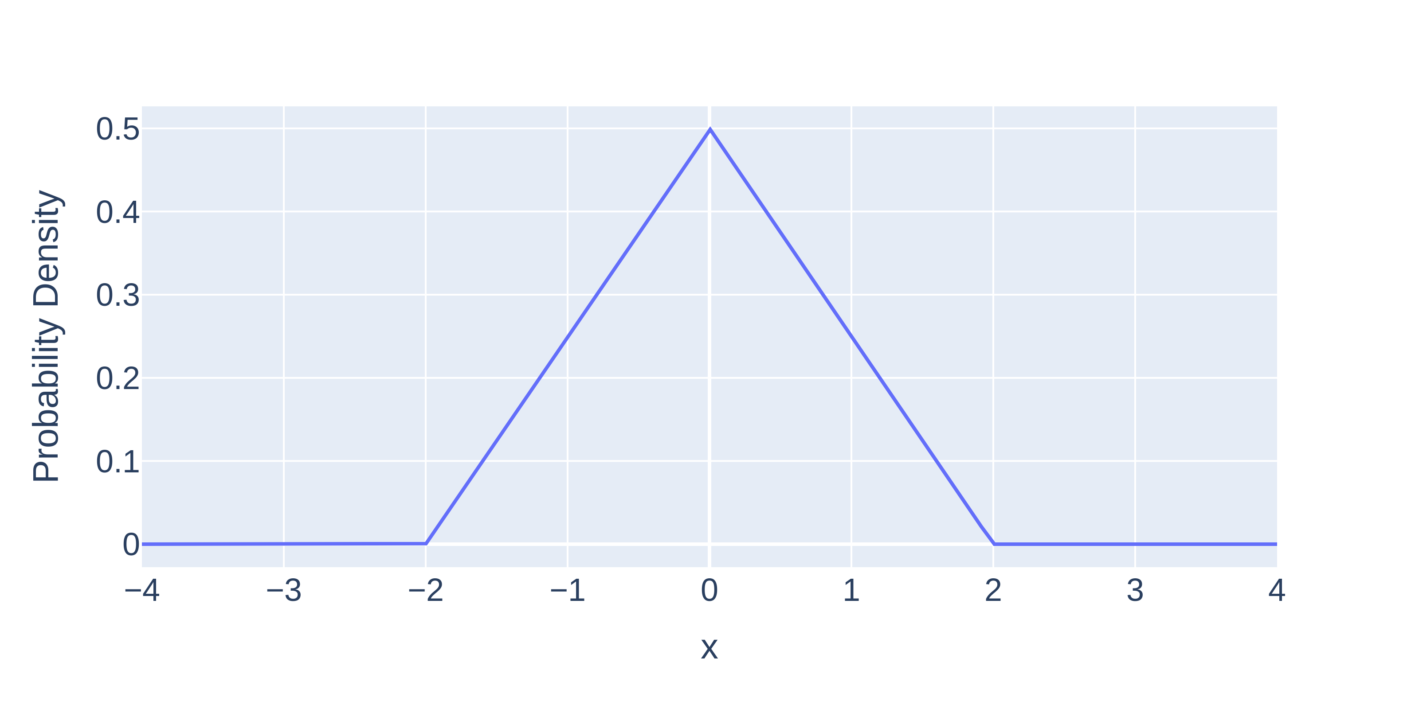

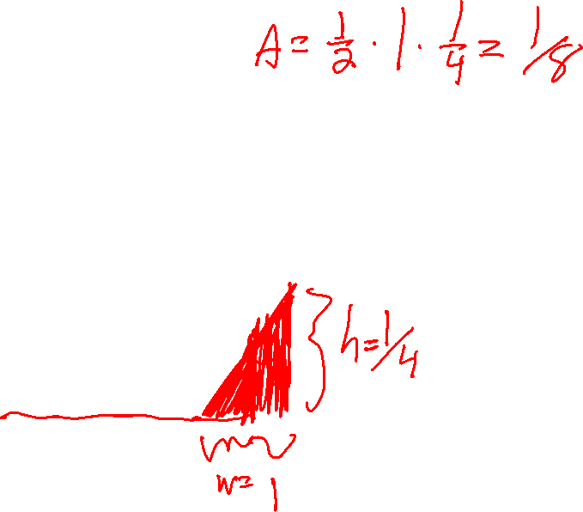
Another Example Distribution: The Triangle Distribution
Consider the distribution below:
What is $P\left(X≤−1\right)$?
https://joshh.ug/B

Slide 11

Another Example Distribution: The Triangle Distribution
Consider the distribution below:
What is $P\left(X≤−1\right)$?
This is a right triangle with base 1, height 1/4, so area is $bh/2=1/8=0.125$

Slide 12

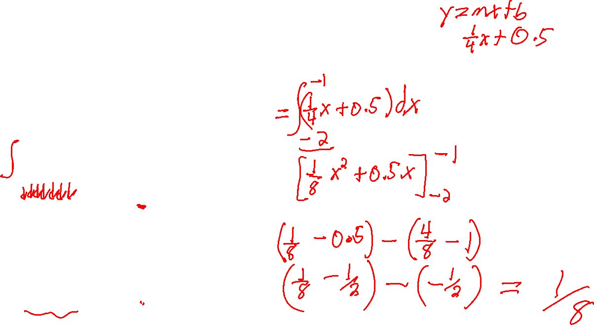
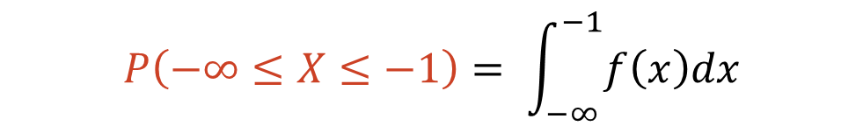
Another Example Distribution: The Triangle Distribution
Consider the distribution below:
What is $P\left(X≤−1\right)$? Can also compute using integration.
$$P\left(−∞≤X≤−1\right)= \int_{−∞}^{−1}{f\left(x\right)dx}$$
Hypotenuse of triangle is a line with slope 0.25 and y-intercept 0.5

Slide 13
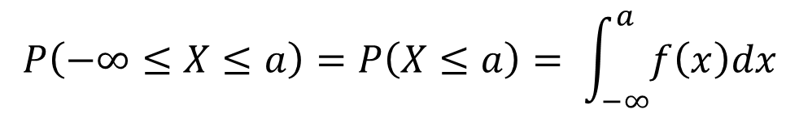
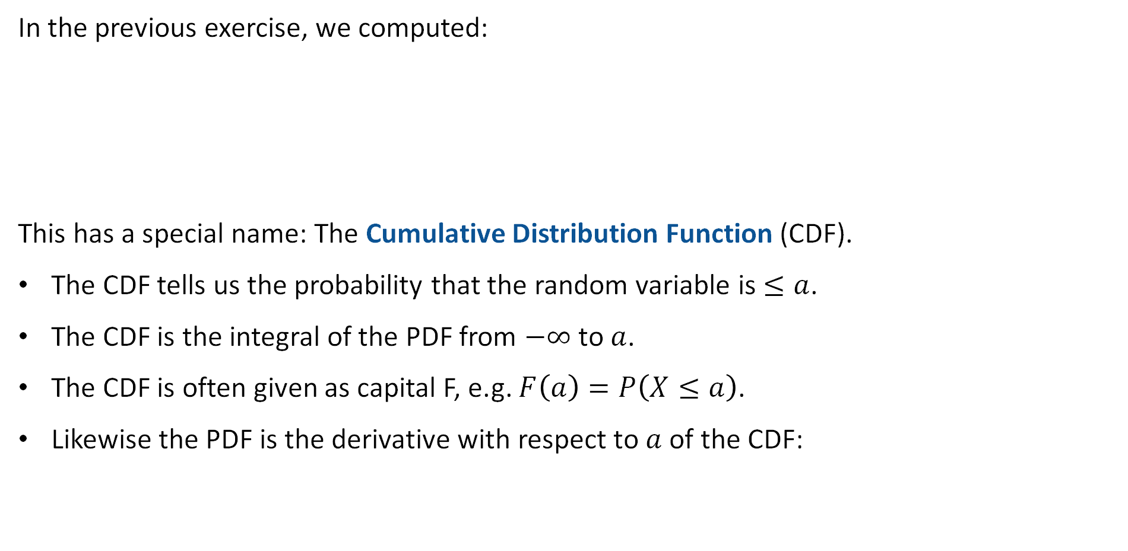
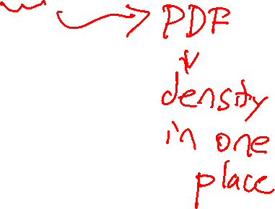

The Cumulative Density Function
In the previous exercise, we computed:
This has a special name: The Cumulative Distribution Function (CDF).
The CDF tells us the probability that the random variable is $≤a$.
The CDF is the integral of the PDF from $−∞$ to $a$.
The CDF is often given as capital F, e.g. $F\left(a\right)=P\left(X≤a\right)$.
Likewise the PDF is the derivative with respect to $a$ of the CDF:
$$P\left(−∞≤X≤a\right)=P\left(X≤a\right)= \int_{−∞}^{a}{f\left(x\right)dx}$$
$$f\left(a\right)=\frac{dF\left(a\right)}{da}$$

Slide 14
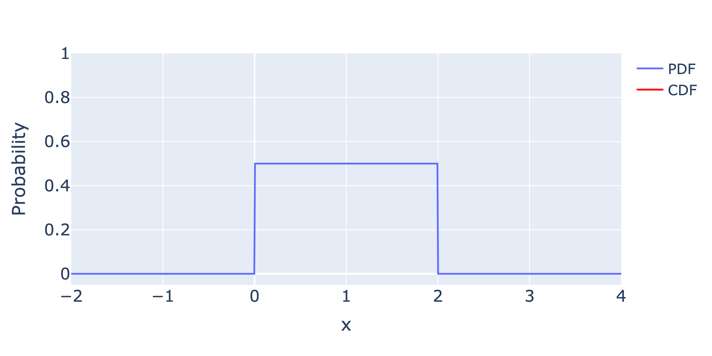

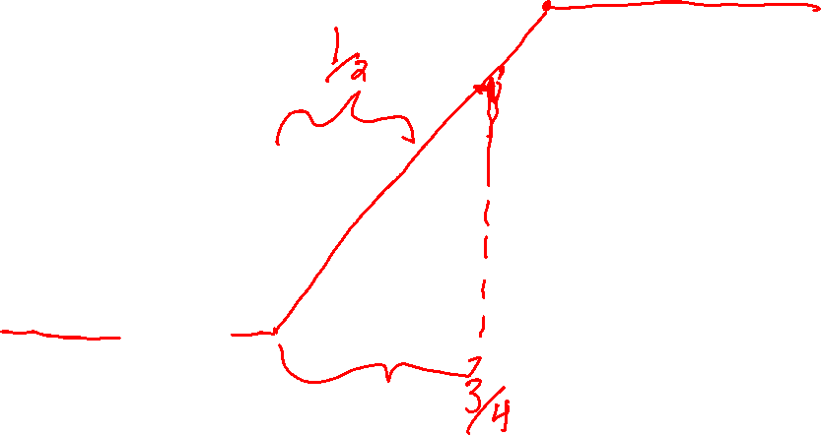

Cumulative Density Function Example 1: Uniform Distribution
Below, we plot the PDF and CDF of the Uniform Distribution together.
Note: The CDF is the integral of the PDF from $−∞$ to x.
Note: The CDF always grows towards 1 (and never exceeds it).
PDF: Probability per unit length
CDF: $P(X≤x)$

Slide 15
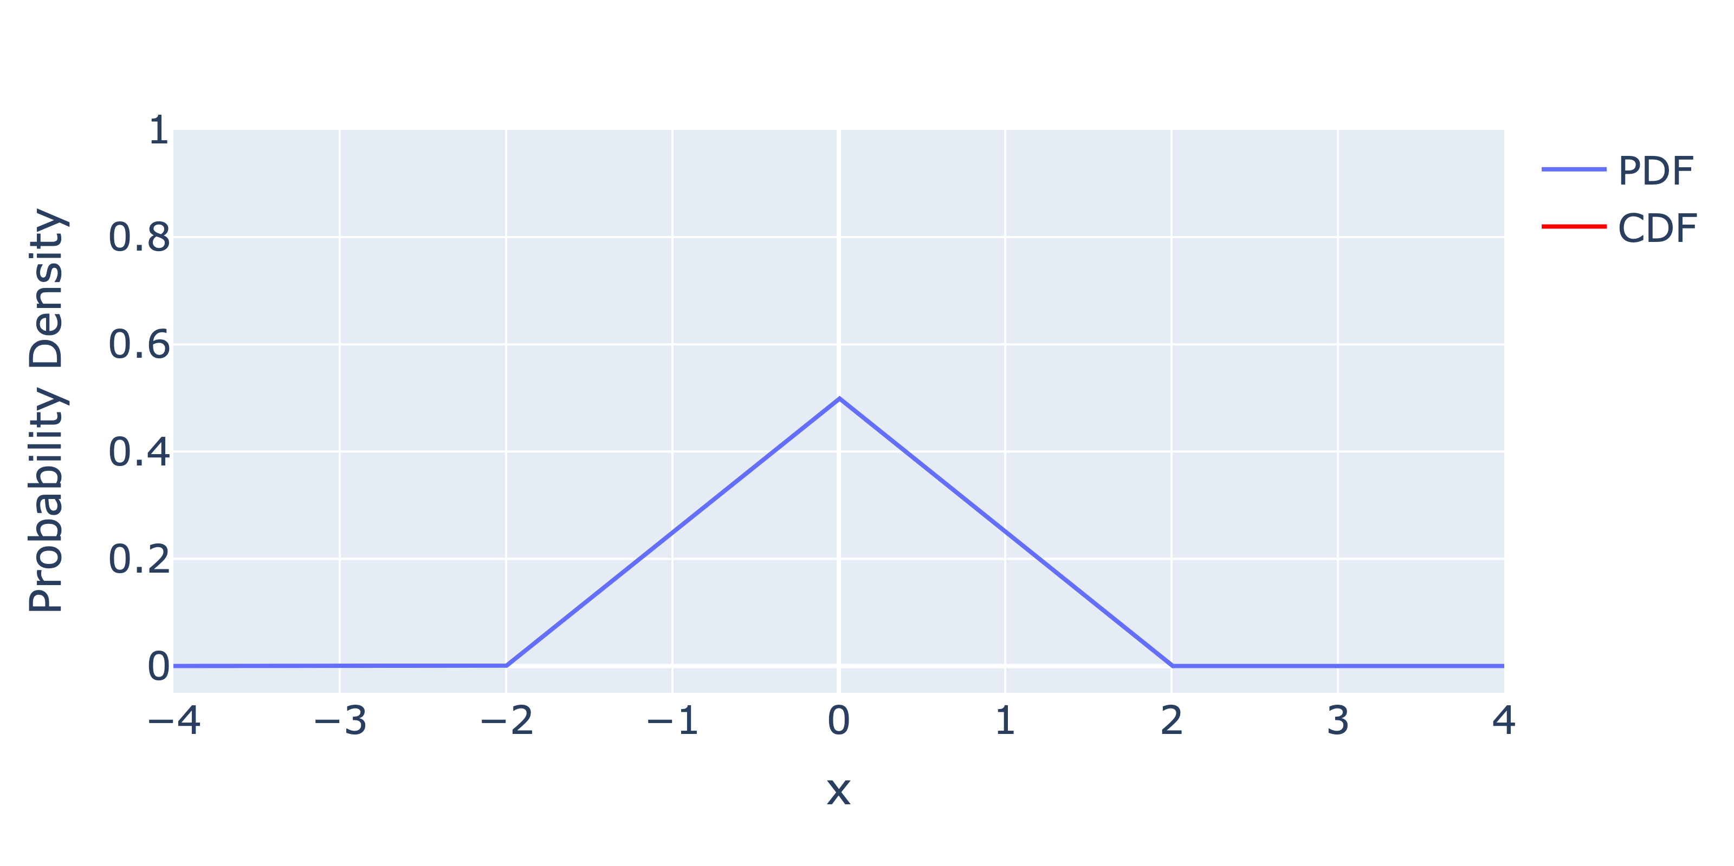

Cumulative Density Function Example 2: Uniform Distribution
Below, we plot the PDF and CDF of the Uniform Distribution together.
Note: The CDF is the integral of the PDF from $−∞$ to x.
Note: The CDF always grows towards 1 (and never exceeds it).
Integral of a line is a parabola.
PDF: Probability per unit length
CDF: $P(X≤x)$

Slide 16
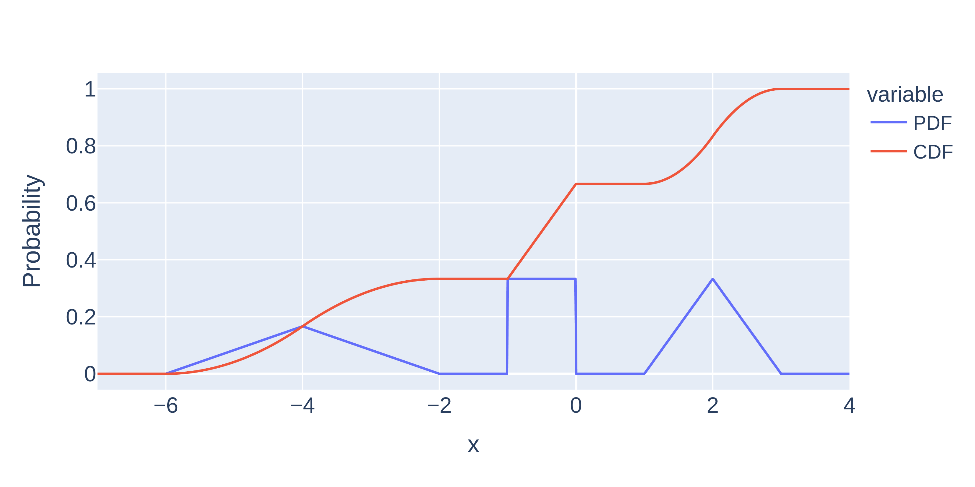
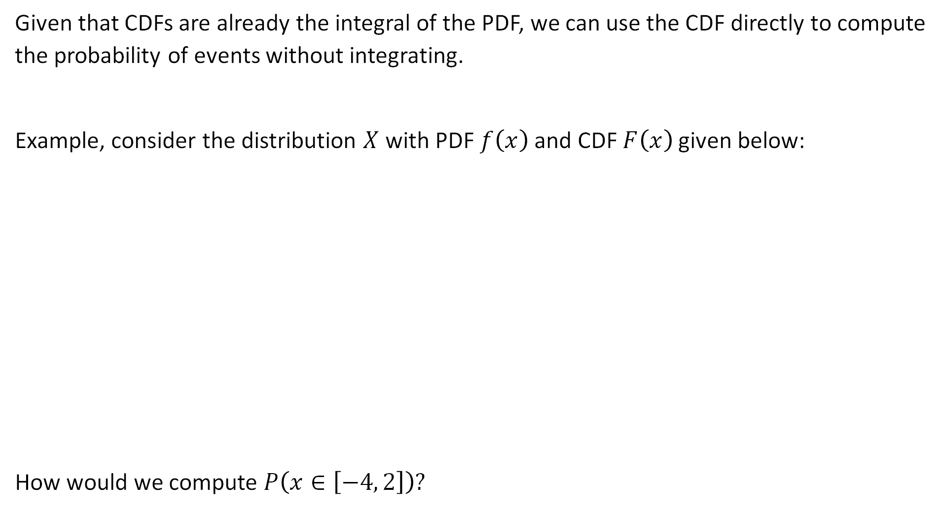
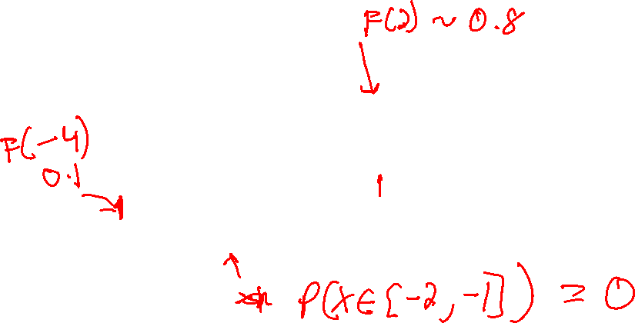
Applying a CDF
Given that CDFs are already the integral of the PDF, we can use the CDF directly to compute the probability of events without integrating.
Example, consider the distribution $X$ with PDF $f\left(x\right)$ and CDF $F\left(x\right)$ given below:
How would we compute $P\left(x∈\left[−4, 2\right]\right)?$

Slide 17
The Exponential Distribution
Continuous Probability Distributions
The Exponential Distribution
Expectation and Variance
Joint Distributions and Independence
Summary and Reflections
Lecture 23, CS70 Fall 2025

Slide 18
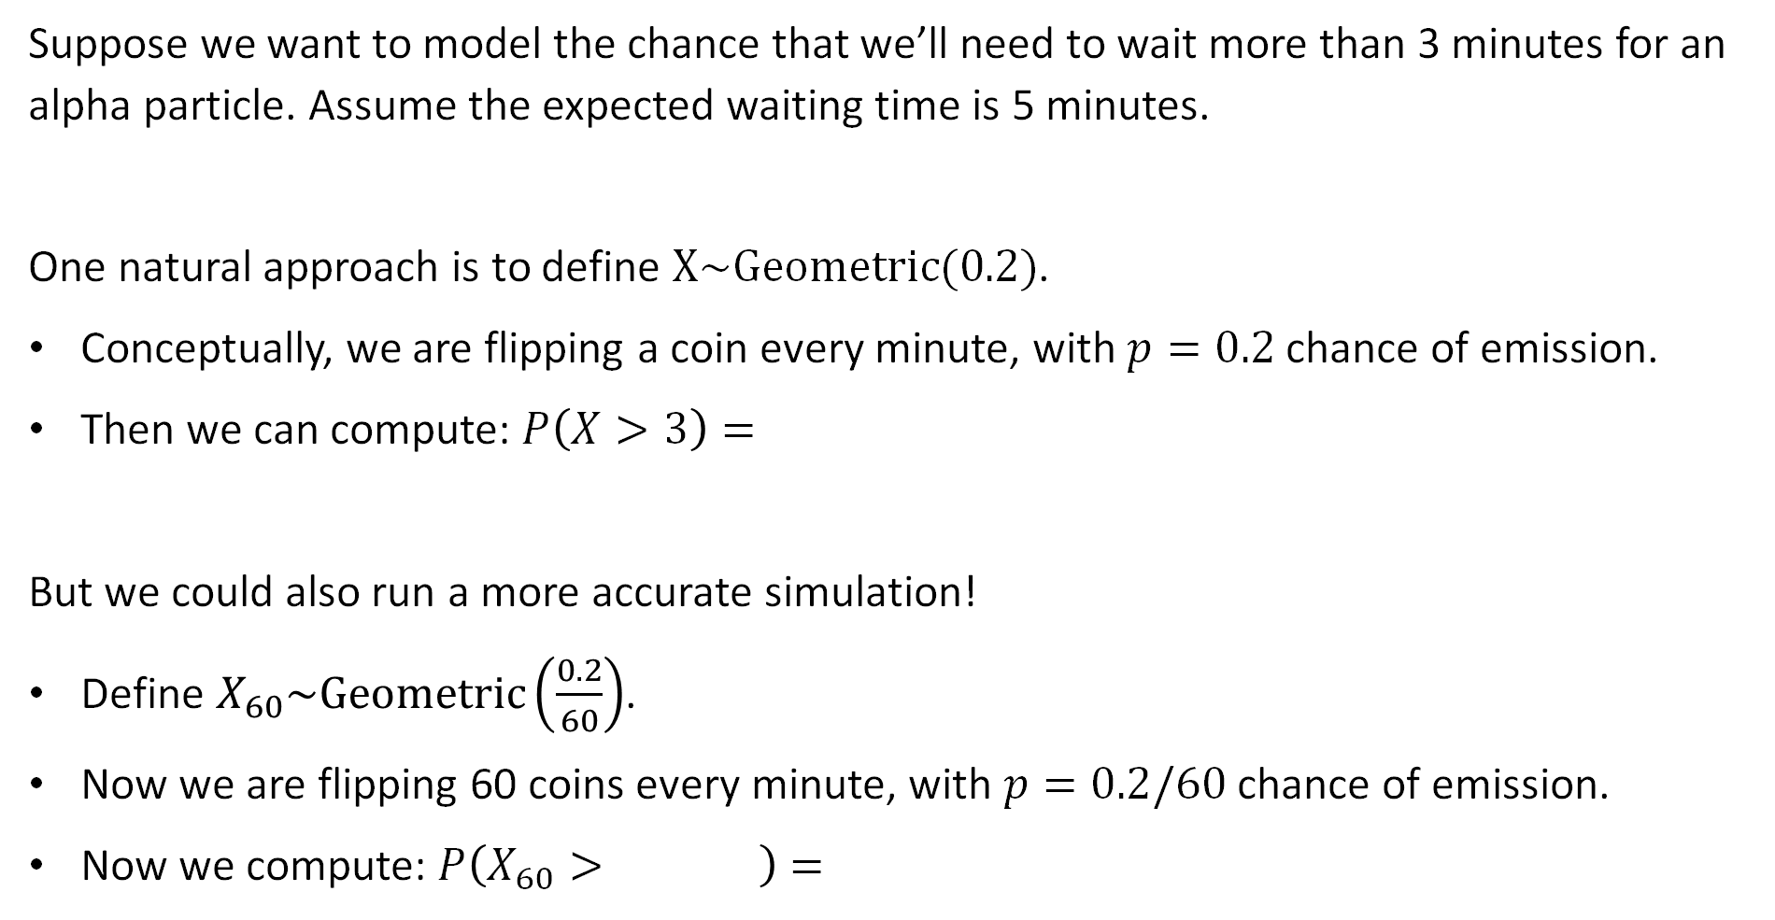
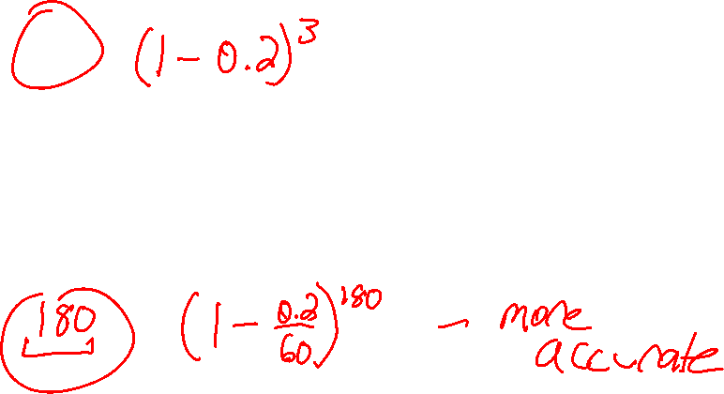
Modeling Problem: Waiting Time for an Emission
Suppose we want to model the chance that we’ll need to wait more than 3 minutes for an alpha particle. Assume the expected waiting time is 5 minutes.
One natural approach is to define $X\sim Geometric(0.2)$.
Conceptually, we are flipping a coin every minute, with $p=0.2$ chance of emission.
Then we can compute: $P\left(X>3\right)=$
But we could also run a more accurate simulation!
Define $X_{60}\sim Geometric\left(\frac{0.2}{60}\right)$.
Now we are flipping 60 coins every minute, with $p=0.2/60$ chance of emission.
Now we compute: $P\left(X_{60}> \right)=$

Slide 19
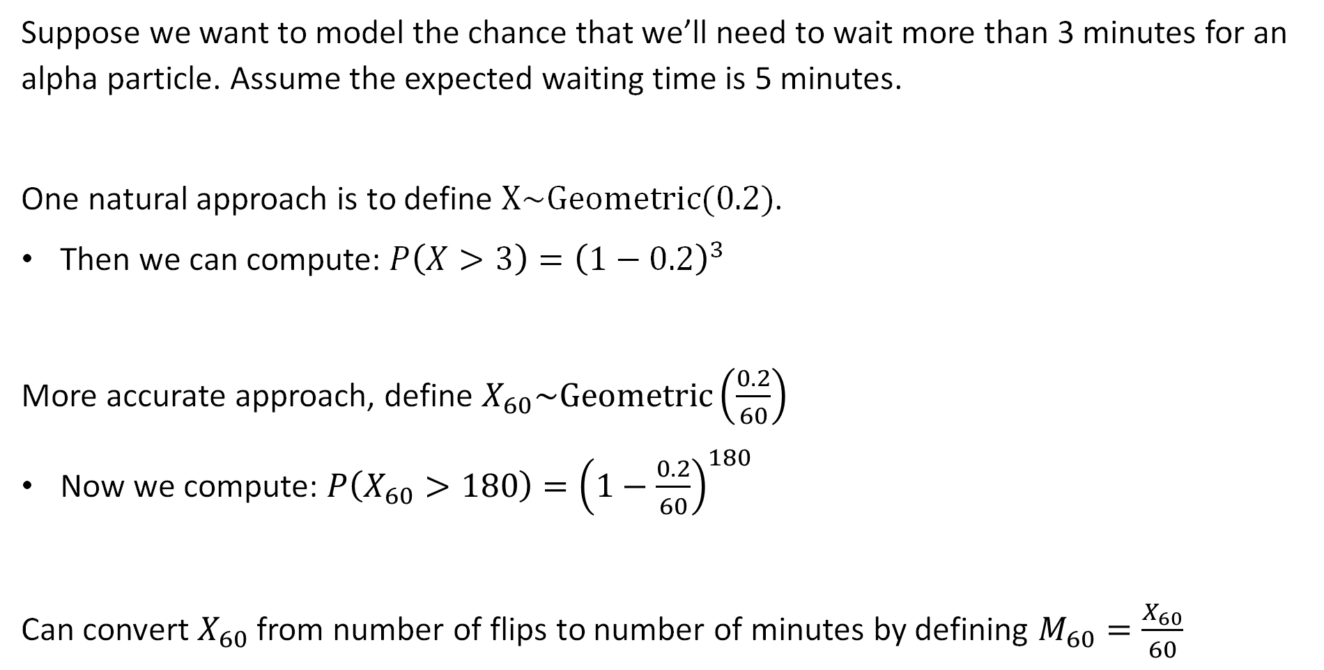

Modeling Problem: Waiting Time for an Emission
Suppose we want to model the chance that we’ll need to wait more than 3 minutes for an alpha particle. Assume the expected waiting time is 5 minutes.
One natural approach is to define $X\sim Geometric(0.2)$.
Then we can compute: $P\left(X>3\right)={\left(1−0.2\right)}^{3}$
More accurate approach, define $X_{60}\sim Geometric\left(\frac{0.2}{60}\right)$
Now we compute: $P\left(X_{60}>180\right)={\left(1−\frac{0.2}{60}\right)}^{180}$
Can convert $X_{60}$ from number of flips to number of minutes by defining $M_{60}=\frac{X_{60}}{60}$

Slide 20
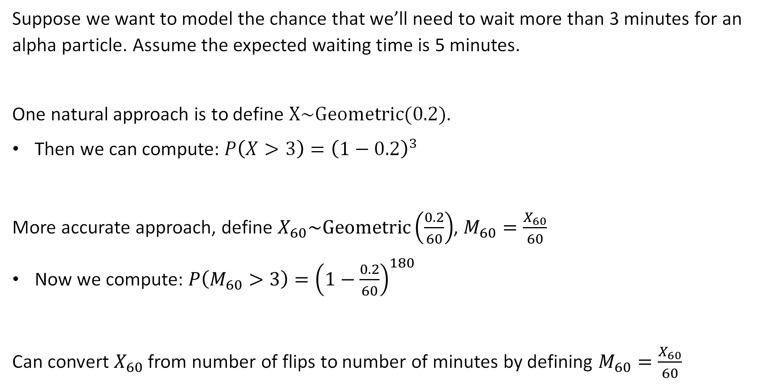

Modeling Problem: Waiting Time for an Emission
Suppose we want to model the chance that we’ll need to wait more than 3 minutes for an alpha particle. Assume the expected waiting time is 5 minutes.
One natural approach is to define $X\sim Geometric(0.2)$.
Then we can compute: $P\left(X>3\right)={\left(1−0.2\right)}^{3}$
More accurate approach, define $X_{60}\sim Geometric\left(\frac{0.2}{60}\right)$, $M_{60}=\frac{X_{60}}{60}$
Now we compute: $P\left(M_{60}>3\right)={\left(1−\frac{0.2}{60}\right)}^{180}$
Can convert $X_{60}$ from number of flips to number of minutes by defining $M_{60}=\frac{X_{60}}{60}$

Slide 21
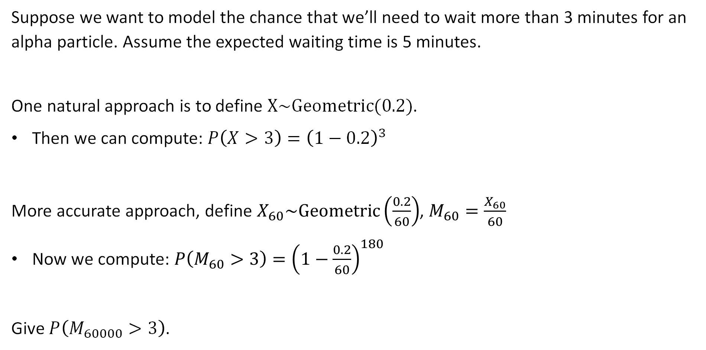
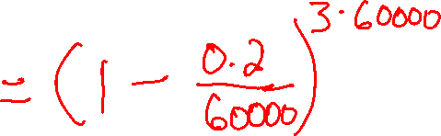
Modeling Problem: Waiting Time for an Emission
Suppose we want to model the chance that we’ll need to wait more than 3 minutes for an alpha particle. Assume the expected waiting time is 5 minutes.
One natural approach is to define $X\sim Geometric(0.2)$.
Then we can compute: $P\left(X>3\right)={\left(1−0.2\right)}^{3}$
More accurate approach, define $X_{60}\sim Geometric\left(\frac{0.2}{60}\right)$, $M_{60}=\frac{X_{60}}{60}$
Now we compute: $P\left(M_{60}>3\right)={\left(1−\frac{0.2}{60}\right)}^{180}$
Give $P\left(M_{60000}>3\right)$.

Slide 22
Modeling Problem: Waiting Time for an Emission
Suppose we want to model the chance that we’ll need to wait more than 3 minutes for an alpha particle. Assume the expected waiting time is 5 minutes.
One natural approach is to define $X\sim Geometric(0.2)$.
Then we can compute: $P\left(X>3\right)={\left(1−0.2\right)}^{3}$
More accurate approach, define $X_{60}\sim Geometric\left(\frac{0.2}{60}\right)$, $M_{60}=\frac{X_{60}}{60}$
Now we compute: $P\left(M_{60}>3\right)={\left(1−\frac{0.2}{60}\right)}^{180}$
Give $P\left(M_{60000}>3\right)$.

Slide 23
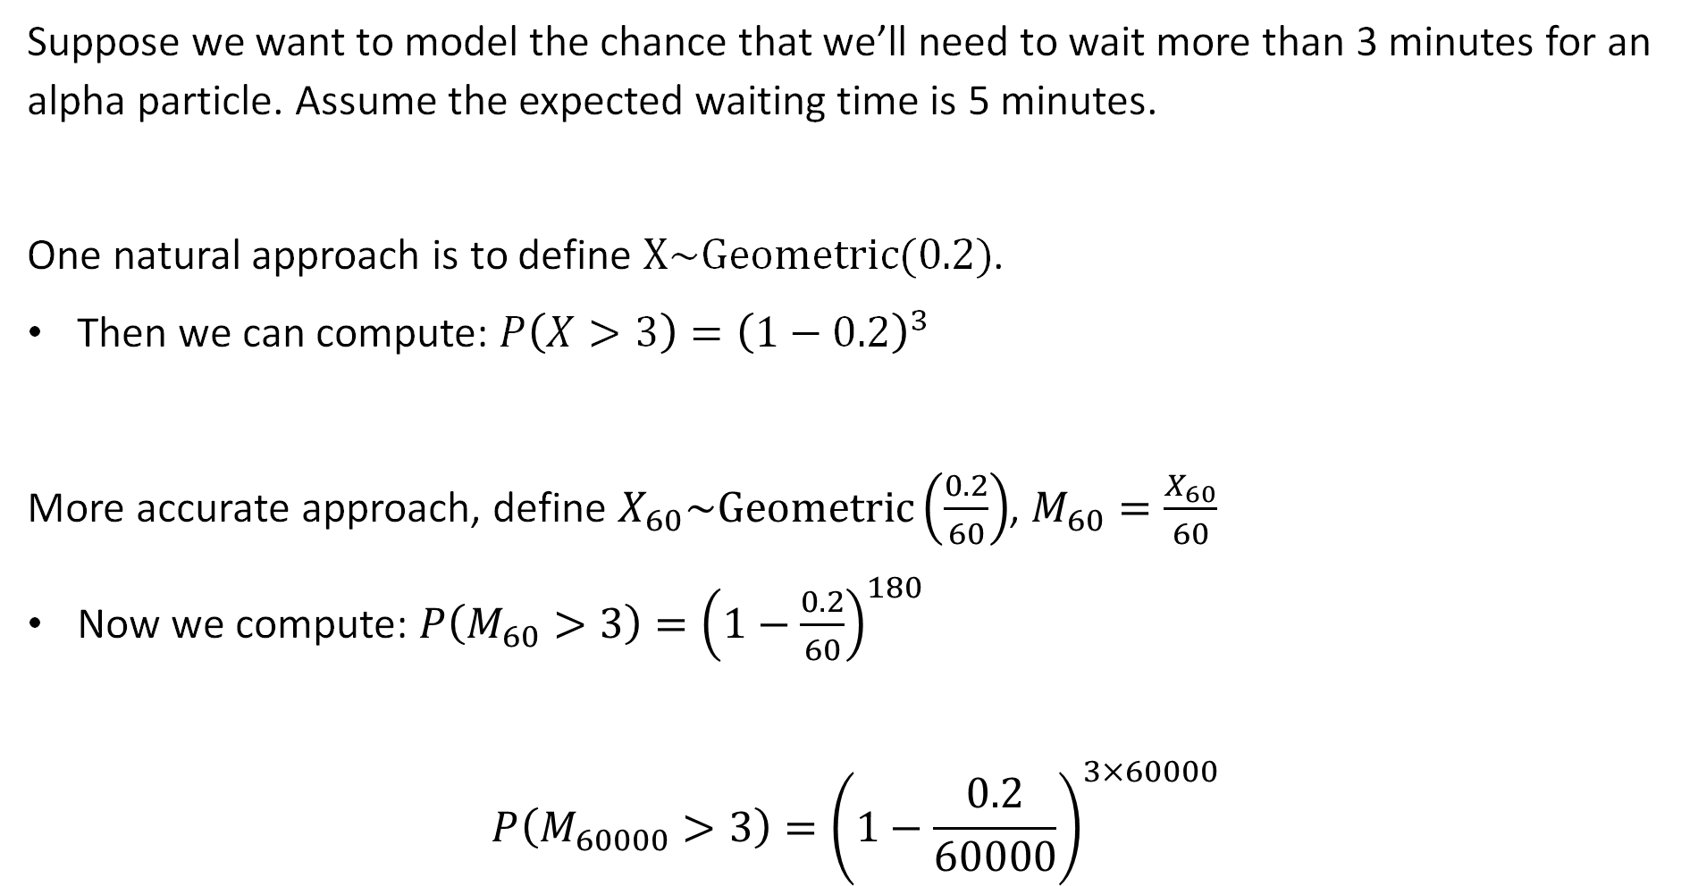
Modeling Problem: Waiting Time for an Emission
Suppose we want to model the chance that we’ll need to wait more than 3 minutes for an alpha particle. Assume the expected waiting time is 5 minutes.
One natural approach is to define $X\sim Geometric(0.2)$.
Then we can compute: $P\left(X>3\right)={\left(1−0.2\right)}^{3}$
More accurate approach, define $X_{60}\sim Geometric\left(\frac{0.2}{60}\right)$, $M_{60}=\frac{X_{60}}{60}$
Now we compute: $P\left(M_{60}>3\right)={\left(1−\frac{0.2}{60}\right)}^{180}$
$$P\left(M_{60000}>3\right)={\left(1−\frac{0.2}{60000}\right)}^{3×60000}$$

Slide 24
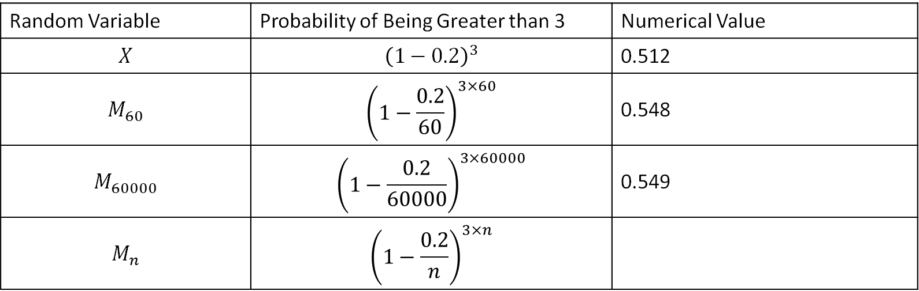
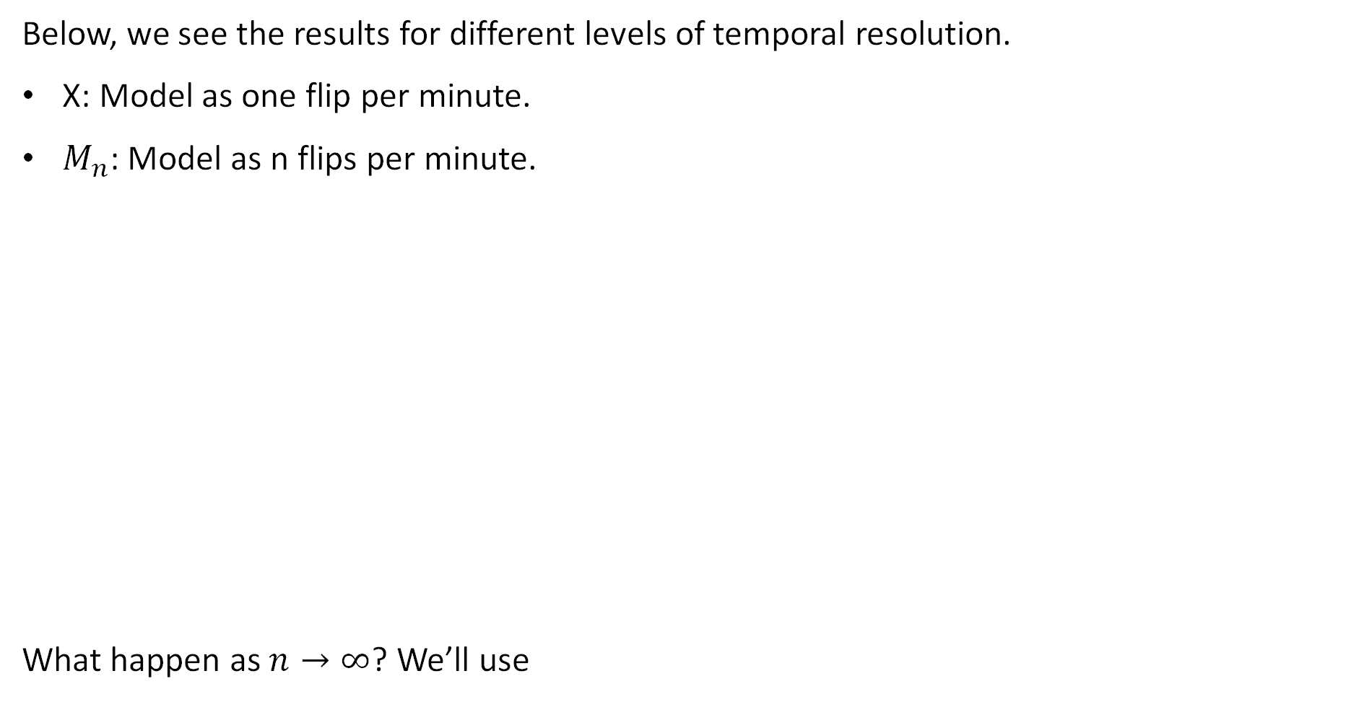
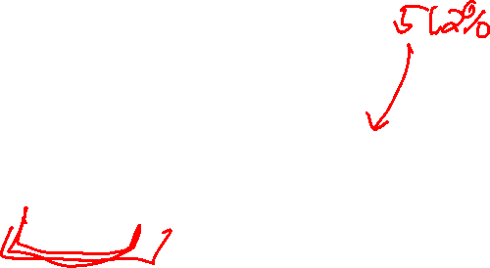
Result vs. Temporal Resolution
Below, we see the results for different levels of temporal resolution.
X: Model as one flip per minute.
$M_{n}$: Model as n flips per minute.
What happen as $n→∞$? We’ll use
Random Variable | Probability of Being Greater than 3 | Numerical Value
$$X$$ | $${\left(1−0.2\right)}^{3}$$ | 0.512
$$M_{60}$$ | $${\left(1−\frac{0.2}{60}\right)}^{3×60}$$ | 0.548
$$M_{60000}$$ | $${\left(1−\frac{0.2}{60000}\right)}^{3×60000}$$ | 0.549
$$M_{n}$$ | $${\left(1−\frac{0.2}{n}\right)}^{3×n}$$
$$\lim_{n→∞}{{\left(1−1/x\right)}^{x}=e^{−1}}$$

Slide 25

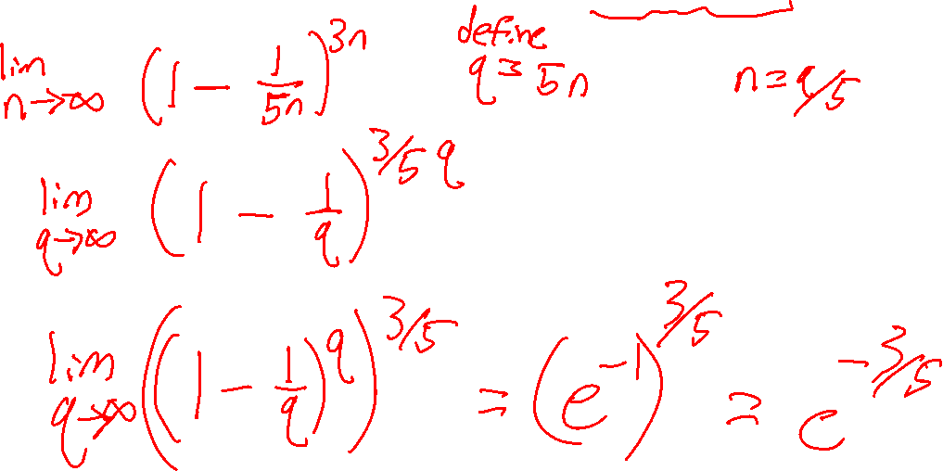
Closed Form for Infinite Temporal Resolution
We have that ${P(M}_{n}>3)={\left(1−\frac{0.2}{n}\right)}^{3×n}$
$$\lim_{n→∞}{{\left(1−1/x\right)}^{x}=e^{−1}}$$

Slide 26

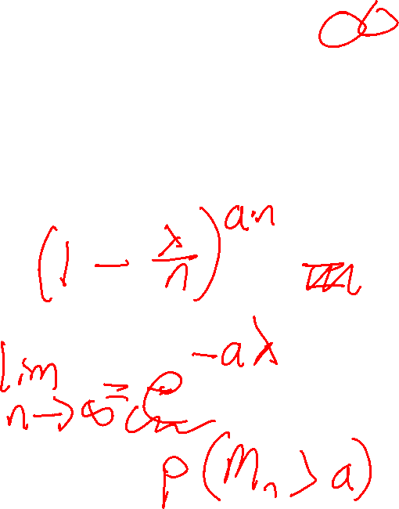
General Closed Form for Infinite Temporal Resolution
We have that for $λ=0.2$, ${P(M}_{n}>3)={\left(1−\frac{0.2}{n}\right)}^{3×n}$
On the previous slide we showed that $P\left(M_{n}>3\right)=e^{−3/5}$
More generally, if we have arbitrary $λ$ and $a$, we can find:
$P\left(M_{n}>a\right)=$
$$\lim_{n→∞}{{\left(1−1/x\right)}^{x}=e^{−1}}$$

Slide 27
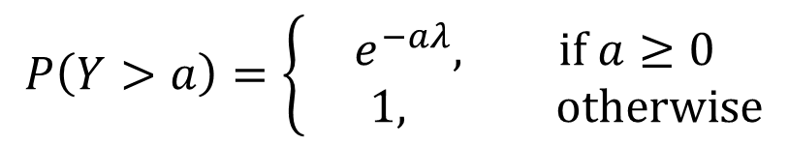


Exponential Distribution
Let Y be the random variable if we crank the temporal resolution of our coin flipping experiment to infinity, i.e. $Y=\lim_{n→∞}{N_{n}}$. Then we have that:
Y is the exponential distribution.
This is a continuous distribution, i.e. $P\left(Y=a\right)=0$ for any specific $a$.
The equation above gives the probability of the event $N_{∞}>a$.
Let’s figure out the CDF and then PDF of this random variable.
$$P\left(Y>a\right)=\left\{\begin{aligned}e^{−aλ}, if a≥0 \\ 1, otherwise\end{aligned}\right.$$

Slide 28



Exponential Distribution
If $Y\sim Exponential\left(λ\right)$, then we know:
What is the CDF of $Y$ for $a≥0$? Reminder, a CDF gives the probability that a random variable is less than or equal to some quantity.
https://joshh.ug/E
$$P\left(Y>a\right)=\left\{\begin{aligned}e^{−aλ}, if a≥0 \\ 1, otherwise\end{aligned}\right.$$

Slide 29





Exponential Distribution
If $Y\sim Exponential\left(λ\right)$, then we know:
Since $P\left(Y≤a\right)=1−P\left(Y>a\right)$, we have that the CDF $F_{Y}\left(a\right)$ is given by:
What is the PDF $f_{Y}\left(a\right)$?
https://joshh.ug/F
$$P\left(Y>a\right)=\left\{\begin{aligned}e^{−aλ}, if a≥0 \\ 0, otherwise\end{aligned}\right.$$
$$P\left(Y≤a\right)=\left\{\begin{aligned}{1−e}^{−aλ}, if a≥0 \\ 0, otherwise\end{aligned}\right.$$

Slide 30





Application of an Exponential Random Variable
Suppose that the that the number of minutes until the next neutrino detection is given by $X\sim Exponential(0.02)$.
What is the chance that the next neutrino detection occurs in the next 100 minutes?
https://joshh.ug/G
$$F_{Y}\left(y\right)=\left\{\begin{aligned}{1−e}^{−λy}, if y≥0 \\ 0, otherwise\end{aligned}\right.$$
$$f_{Y}\left(y\right)=\left\{\begin{aligned}{λe}^{−λy}, if y≥0 \\ 0, otherwise\end{aligned}\right.$$

Slide 31

Application of an Exponential Random Variable
Suppose that the that the number of minutes until the next neutrino detection is given by $X\sim Exponential(0.02)$.
What is the chance that the next neutrino detection occurs in the next 100 minutes?
Easiest to use the CDF! We want $F_{Y}\left(100\right)=P\left(Y<100\right)$
$$F_{Y}\left(y\right)=\left\{\begin{aligned}{1−e}^{−λy}, if y≥0 \\ 0, otherwise\end{aligned}\right.$$
$$=1−e^{−100∗0.02}$$
$$=86.47\%$$

Slide 32



The PDF and CDF of an Exponential Random Variable (Visually)
Below are the PDF and CDF of $X\sim Exponential(2)$.
From the plot, how do we verify the area under the PDF is 1?

Slide 33
Expectation and Variance
Continuous Probability Distributions
The Exponential Distribution
Expectation and Variance
Joint Distributions and Independence
Summary and Reflections
Lecture 23, CS70 Fall 2025

Slide 34

Expectation of a Continuous Random Variable
What do you think are the expectations of the random variables below?

Slide 35
Expectation of a Continuous Random Variable
What do you think are the expectations of the random variables below?
x=1
x=0

Slide 36


Expectation of a Geometric Random Variable
What do you think is the expectation of $X\sim Geometric(2)$?
https://joshh.ug/H

Slide 37


Definition of Expectation for Continuous Random Variable
If $X$ is a random variable with PDF $f_{X}\left(x\right)$, then $𝔼\left[X\right]$ is:
$$𝔼\left[X\right]=\int_{−∞}^{∞}{x⋅f_{X}\left(x\right)dx}$$
Contrast with our discrete expectation formula:
$$𝔼\left[X\right]=\sum_{x∈range(X)}{x⋅P(X=x)}$$

Slide 38




Expectation for $X\sim Geometric\left(λ\right)$
To compute the $𝔼\left[X\right]$ where $X\sim Geometric\left(λ\right)$, we integrate over the PDF of our exponential random variable.
$$f_{X}\left(x\right)=\left\{\begin{aligned}{λe}^{−λx}, if x≥0 \\ 0, otherwise\end{aligned}\right.$$
$$𝔼\left[X\right]=\int_{0}^{∞}{x⋅λe^{−λx}dx}$$
Recall Integration by Parts from HW1:
$$\int_{a}^{b}{u\left(x\right)⋅v^{′}\left(x\right)dx={\left.u\left(x\right)⋅v\left(x\right)\right|}_{a}^{b}}−\int_{a}^{b}{u^{′}\left(x\right)⋅v\left(x\right)dx}$$

Slide 39






Expectation for $X\sim Geometric\left(λ\right)$
To compute the $𝔼\left[X\right]$ where $X\sim Geometric\left(λ\right)$, we integrate over the PDF of our exponential random variable.
$$f_{X}\left(x\right)=\left\{\begin{aligned}{λe}^{−λx}, if x≥0 \\ 0, otherwise\end{aligned}\right.$$
$$𝔼\left[X\right]=\int_{0}^{∞}{x⋅λe^{−λx}dx}$$
$$=$$
$$u(x)$$
$$v′(x)$$
Recall Integration by Parts from HW1:
$$\int_{a}^{b}{u\left(x\right)⋅v^{′}\left(x\right)dx={\left.u\left(x\right)⋅v\left(x\right)\right|}_{a}^{b}}−\int_{a}^{b}{u^{′}\left(x\right)⋅v\left(x\right)dx}$$

Slide 40

Expectation of a Geometric Random Variable
What do you think is the expectation of $X\sim Geometric(2)$?
Answer:$1/λ=1/2$

Slide 41


Definition of Variance for Continuous Random Variable
If $X$ is a random variable with PDF $f_{X}\left(x\right)$, then $var\left(X\right)$ is:
$$var\left(X\right)=𝔼\left[X^{2}\right]−𝔼{\left[X\right]}^{2}$$
$$=\int_{−∞}^{∞}{x^{2}⋅f_{X}\left(x\right)dx}−{\left(\int_{−∞}^{∞}{x⋅f_{X}\left(x\right)dx}\right)}^{2}$$

Slide 42





Expectation for $X\sim Geometric\left(λ\right)$
To compute the variance, we’ll need $𝔼\left[X^{2}\right]$. Luckily this isn’t so bad.
$$f_{X}\left(x\right)=\left\{\begin{aligned}{λe}^{−λx}, if x≥0 \\ 0, otherwise\end{aligned}\right.$$
$$𝔼\left[X\right]=\int_{0}^{∞}{λxe^{−λx}dx=\frac{1}{λ}}$$
$$𝔼\left[X^{2}\right]=\int_{0}^{∞}{x^{2}⋅λe^{−λx}dx}$$
$$=$$
$$u(x)$$
$$v′(x)$$
Recall Integration by Parts from HW1:
$$\int_{a}^{b}{u\left(x\right)⋅v^{′}\left(x\right)dx={\left.u\left(x\right)⋅v\left(x\right)\right|}_{a}^{b}}−\int_{a}^{b}{u^{′}\left(x\right)⋅v\left(x\right)dx}$$

Slide 43



Expectation for $X\sim Geometric\left(λ\right)$
To compute the variance, we’ll need $𝔼\left[X^{2}\right]$. Luckily this isn’t so bad.
$$f_{X}\left(x\right)=\left\{\begin{aligned}{λe}^{−λx}, if x≥0 \\ 0, otherwise\end{aligned}\right.$$
$$𝔼\left[X\right]=\int_{0}^{∞}{λxe^{−λx}dx=\frac{1}{λ}}$$
$$𝔼\left[X^{2}\right]=\frac{2}{λ^{2}}$$
$$var\left(X\right)=\frac{2}{λ^{2}}−\frac{1}{λ^{2}}=\frac{1}{λ^{2}}$$

Slide 44








Geometric vs. Exponential
Compare $C\sim Exponential\left(λ\right)$ and $D\sim Geometric\left(λ\right)$
$$p.d.f. f\left(d\right)=λe^{−λd}$$
$$PMF: {\left(1−λ\right)}^{d−1}λ$$
$$𝔼\left[C\right]=\frac{1}{λ}$$
$$𝔼\left[D\right]=\frac{1}{λ}$$
$$var(C)=\frac{1}{λ^{2}}$$
$$var(D)=\frac{1−λ}{λ^{2}}$$

Slide 45






Expectation and Variance of a Uniform Random Variable
In the notes, they show that if $X$ is a uniform random variable over $\left[0, ℓ\right]$:
See notes (or just show yourself) for a proof. Contrast with $D$ uniform over $\{1,2,…,n\}$, which was:
$$𝔼\left[X\right]=\frac{ℓ}{2}$$
$$var\left(X\right)=\frac{ℓ^{2}}{12}$$
$$𝔼\left[D\right]=\frac{n+1}{2}$$
$$var\left(X\right)=\frac{n^{2}−1}{12}$$

Slide 46
Joint Distributions and Independence
Continuous Probability Distributions
The Exponential Distribution
Expectation and Variance
Joint Distributions and Independence
Summary and Reflections
Lecture 23, CS70 Fall 2025

Slide 47
Joint Distributions and Independence
Our usual ideas from discrete probability around joint distributions, marginal distributions, and independence carry over very closely.

Slide 48



Review: Joint Distributions (Discrete)
To refresh our memory on joint distributions, let’s first consider the joint PMF of two discrete uniform random variables $X$ and$Y$ representing the roll of two independent four sided dice.
What is the joint PMF of $X$ and $Y$?
$$x$$ | $$y$$ | $$P\left(X=x,Y=y\right)$$
1 | 1 | 1/16
1 | 2 | 1/16
1 | 3 | 1/16
1 | 4 | 1/16
2 | 1 | 1/16
2 | 2 | 1/16
2 | 3 | 1/16
2 | 4 | 1/16
3 | 1 | 1/16
3 | 2 | 1/16
3 | 3 | 1/16
3 | 4 | 1/16
4 | 1 | 1/16
4 | 2 | 1/16
4 | 3 | 1/16
4 | 4 | 1/16

Slide 49




Joint Density
Suppose we have random variables $X$ and $Y$ which are continuous. Then their joint PDF is a non-negative function $f_{X,Y}\left(x,y\right)$ such that:
And for all $a<b$ and $c<d$, we have:
Can interpret PDF as probability that we are in a small rectangle around $x, y$.
Actual probability is zero since the rectangle infinitesimal.
$$\int_{−∞}^{∞}{\int_{−∞}^{∞}{f_{X,Y}\left(x,y\right) dx dy }=1}$$
$$P\left(a≤X≤b, c≤Y≤d\right)=\int_{c}^{d}{\int_{a}^{b}{f_{X,Y}\left(x,y\right) dx dy }}$$

Slide 50


Joint Density Example
Suppose we have random variables $X$ and $Y$ which are continuous. Then their joint PDF is a non-negative function $f_{X,Y}\left(x,y\right)$ such that:
Suppose we throw a dart at the origin. Suppose we land uniformly within 2 feet of the origin.
$$\int_{−∞}^{∞}{\int_{−∞}^{∞}{f_{X,Y}\left(x,y\right) dx dy }=1}$$
$$f_{X,Y}\left(x,y\right)=\left\{\begin{aligned}\frac{1}{4π}, if x^{2}+y^{2} ≤4 \\ 0, otherwise\end{aligned}\right.$$
2 foot radius

Slide 51


Marginal Probabilities
Suppose we have random variables $X$ and $Y$ which are continuous. Then their joint PDF is a non-negative function $f_{X,Y}\left(x,y\right)$ such that:
Similar to marginal probabilities for discrete random variables, we can compute $f_{X}\left(x\right)$ and $f_{Y}\left(y\right)$. How?
$$\int_{−∞}^{∞}{\int_{−∞}^{∞}{f_{X,Y}\left(x,y\right) dx dy }=1}$$

Slide 52



Marginal Probabilities
Suppose we have random variables $X$ and $Y$ which are continuous. Then their joint PDF is a non-negative function $f_{X,Y}\left(x,y\right)$ such that:
Similar to marginal probabilities for discrete random variables, we can compute $f_{X}\left(x\right)$ and $f_{Y}\left(y\right)$. How?
$$\int_{−∞}^{∞}{\int_{−∞}^{∞}{f_{X,Y}\left(x,y\right) dx dy }=1}$$
$$f_{X}\left(x\right)=\int_{−∞}^{∞}{f_{X,Y}\left(x,y\right) dy }$$
$$f_{Y}\left(y\right)=\int_{−∞}^{∞}{f_{X,Y}\left(x,y\right) dx }$$

Slide 53




Marginal Density Example
Suppose we throw a dart at the origin. Suppose we land uniformly within 2 feet of the origin. Then $X$ and $Y$ are jointly distributed as:
What is the distribution of $X$, e.g. what is the p.d.f. $f_{X}\left(x\right)$?
$$f_{X,Y}\left(x,y\right)=\left\{\begin{aligned}\frac{1}{4π}, if x^{2}+y^{2} ≤4 \\ 0, otherwise\end{aligned}\right.$$
2 foot radius
$$f_{X}\left(x\right)=\int_{−∞}^{∞}{f_{X,Y}\left(x,y\right) dy }$$

Slide 54


Marginal Density Example
Suppose we throw a dart at the origin. Suppose we land uniformly within 2 feet of the origin. Then $X$ and $Y$ are jointly distributed as:
What is the distribution of $X$, e.g. what is the p.d.f. $f_{X}\left(x\right)$?
$$f_{X}\left(x\right)=\left\{\begin{aligned}\frac{\sqrt{4−x^{2}}}{2π}, if x∈[−2, 2] \\ 0, otherwise\end{aligned}\right.$$
$$f_{X,Y}\left(x,y\right)=\left\{\begin{aligned}\frac{1}{4π}, if x^{2}+y^{2} ≤4 \\ 0, otherwise\end{aligned}\right.$$
2 foot radius

Slide 55


Independent Random Variables
We can define $X$ and $Y$ to be independent continuous random variables if for all $a<b$ and $c<d$, the following holds true:
$$P\left(a≤X≤b, c≤Y≤d\right)=P\left(a≤X≤b\right)⋅P\left(c≤Y≤d\right)$$
Or equivalently (without proof, see notes): If $f_{X, Y}\left(x,y\right)=f_{X}\left(x\right)⋅f_{Y}\left(y\right)$ for all $x, y$
For the dart example earlier, where X and Y independent?
Why or why not?
2 foot radius

Slide 56

Independent Random Variables
We can define $X$ and $Y$ to be independent continuous random variables if for all $a<b$ and $c<d$, the following holds true:
$$P\left(a≤X≤b, c≤Y≤d\right)=P\left(a≤X≤b\right)⋅P\left(c≤Y≤d\right)$$
Or equivalently (without proof, see notes): If $f_{X, Y}\left(x,y\right)=f_{X}\left(x\right)⋅f_{Y}\left(y\right)$ for all $x, y$
For the dart example earlier, where X and Y independent?
Not independent! Example If x = 2, y must be zero.
2 foot radius

Slide 57
Summary and Reflections
Continuous Probability Distributions
The Exponential Distribution
Expectation and Variance
Joint Distributions and Independence
Summary and Reflections
Lecture 23, CS70 Fall 2025

Slide 58

Discrete vs. Continuous Probability Distributions
Before today, our random variables variables had a discrete range, i.e. either finite or countably infinite. Example: $range\left(Geometric\right)=\left\{1, 2, …\right\}$
We considered the space of sample points first, e.g. $TTTTTH$, and later defined events in terms of sums of probabilities of sample points.
Example, if $X\sim Binomial(3, 0.5)$, then:
  $P\left(X=1\right)=P\left(ω=HTT\right)+P\left(ω=THT\right)+P(ω=TTH)$
The probability of an event defined by random variable equality was given by the “probability mass function”. We did not use this term before today.
  Example: pmf of $X$ above is $P\left(X=k\right)=\left({3 \atop k}\right){0.5}^{k}{0.5}^{k−3}$ for $k∈[0, 1, 2, 3]$

Slide 59

Discrete vs. Continuous Probability Distributions
Before today, our random variables variables had a discrete range, i.e. either finite or countably infinite. Example: $range\left(Geometric\right)=\left\{1, 2, …\right\}$
We considered the space of sample points first, e.g. $TTTTTH$, and later defined events in terms of sums of probabilities of sample points.
By contrast, for continuous probability distributions, we think about events first.
CDF gives $P\left(X≤a\right)$, which is the probability of the event that $X$ is less than or equal to a.
Probability of any specific outcome is zero!
More generally, we only ever care about the probability of intervals (or unions of intervals).
PDF is the continuous analog of the PMF, but PDF outputs are not probabilities.

